Slide 1


Faculty of Computing and Informatics
Week 8
Data Manipulation Language(DML)
Database Implementation

Slide 2
Recap
In the previous lesson, we discussed:
SQL
The categories of SQL commands
SQL statement to define database structures

Slide 3
Recap – syntax
Create a database
CREATE database databasename;
CREATE TABLE
CREATE TABLE TableName
( AttributeName Domain [ Constraint ] ........
AttributeName Domain [ Constraint ] [ OtherConstraints ] );

Slide 4
Recap -syntax
Alter table
ALTER TABLE table_name ADD column_name column-definition;
ALTER TABLE table_name MODIFY column_name column_type;
ALTER TABLE table_name
RENAME COLUMN old_name to new_name;

Slide 5
Recap
Drop a database
DROP DATABASE database_name;
Drop a table
DROP TABLE table_name;
TRUNCATE TABLE table_name;

Slide 6
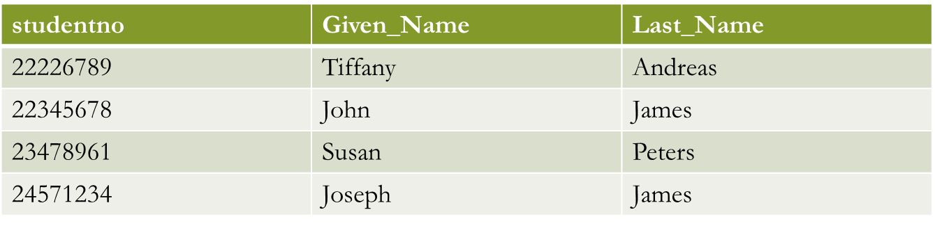
Recap Activity
Given the values for the attributes, what datatypes can you assign for each of the given attributes
Create this table, Student
We will use this table for illustrations in this lesson.

Slide 7
Objectives
By the end of this lesson, students should be able to:
Understand the DML commands
Write DML statements to manipulate database objects
Use the SELECT command
Use appropriate operators to manipulate the database objects

Slide 8
Data Manipulation Language
Data Manipulation Language (DML) is the part of SQL used to manipulate data within objects of a relational database.
it is used to store, modify, retrieve, delete and update data in a database
The most basic DML commands:
INSERT - insert data into a table
UPDATE - updates existing data within a table
DELETE - Delete all records from a database table

Slide 9
Data Manipulation Language
INSERT INTO TABLE_NAME
(col1, col2, col3,.... col N)
VALUES (value1, value2, value3, .... valueN);
INSERT INTO Student
VALUES (122929, ‘F’, ”John”);
INSERT INTO TABLE_NAME
VALUES (value1, value2, value3, .... valueN);
The INSERT statement is used to insert data into a row in a table, use one of these
The list of values must match the table structure exactly in the number of attributes and the data type of each attribute.
Tablename- is the table you want to insert data into
Columnname- name of column as defined in the table
Values- the value you want to insert into that column

Slide 10
Data Manipulation Language
Insert the details of John James with studentnumber 22226789 into the Students table
Write all possible statements to achieve this task
Studentno | Given_Name | Last_Name

Slide 11
Data Manipulation Language
INSERT INTO Student values
(22226789, “John”, “James”);
INSERT INTO Student (Studentno,Given_Name, Last_Name)
Values (22226789,”John”,”James”);

Slide 12
Data Manipulation Language
This command is used to update or modify the value of a column in the table.
To update all column values, exclude the where clause from the statement
To WHERE statement indicates the condition that needs to be met for the update to take place
UPDATE table_name
SET column1 = value1, column2 = value2,column = valuen;
UPDATE table_name
SET column1 = value1, column2 = value2, ...
WHERE condition;

Slide 13
Data Manipulation Language
We use operators to formulate the WHERE clause
Can use comparison operators:
= , <> equals,
not-equals (!= also usually supported)
<= less than, less or equal >,
>= greater than, greater or equal
Can refer to any attribute in FROM clause
Can include arithmetic expressions in comparison

Slide 14
Data Manipulation Language
To update John James student number to 12345678, we can use the following statement
UPDATE Student
SET Studentno =12345678
WHERE Studentno = 22226789;

Slide 15
Data Manipulation Language
Can use comparison operators:
= , <> equals,
not-equals (!= also usually supported)
<= less than, less or equal >,
>= greater than, greater or equal
We use operators to formulate the WHERE clause
Can refer to any attribute in FROM clause
Can include arithmetic expressions in comparison

Slide 16
Data Manipulation Language
Can use AND, OR, NOT in WHERE clause
UPDATE table_name
SET column1 = value1, column2 = value2, ...
WHERE condition1 AND condition2;
UPDATE table_name
SET column1 = value1, column2 = value2, ...
WHERE condition1 OR condition2;
AND- both conditions must be satisfied for update to take place
OR - one of the specified conditions must be true for the update to take place
NOT- all conditions must be false for the update to take place

Slide 17
Data Manipulation Language
The DELETE statement is used to delete data stored in a table.
DELETE FROM table_name WHERE condition;
Table name represents the table where data is to be deleted
The where statement indicates the condition that needs to be met for the delete to take place
Excluding the where command indicates that you want to delete content of every column in the table

Slide 18
Data Manipulation Language
Write a statement to delete the details of John James with student number 12345678 from the list of students

Slide 19
Data Manipulation Language
Given the following tables,
Course
write SQL statements to
Create the table and insert the details
Change the duration of SAD210S to 5
Pk courseId varchar(7)
Description varchar(30)
Duration int
courseId | Description | Duration
CSC100S | Introduction | 3
SAD210S | Analysis and Design | 2

Slide 20
Activity
Write all possible SQL statements to populate the table Student (you created as a recap activity when class started)

Slide 21

SELECT
To retrieve data from the database we can use the SELECT command
SELECT will retrieve information from the database that matches the specified criteria using the SELECT/FROM/WHERE framework.
SELECT
FROM
WHERE
When you want to retrieve data based on certain criteria, the WHERE clause comes in handy allowing you to specify the condition.

Slide 22
SELECT
A query pulls information from one or more relations and creates (temporarily) a new relation.
A SQL query is a “select-from-where” expression
Nested subqueries are “select-from-where” expressions embedded within another query.
This allows a query to:
  Create a new relation
  Feed information to another query (as a “sub-query”)

Slide 23
SELECT …WHERE
SELECT col1,col2,…coln
FROM tablename;
SELECT col1,col2,…coln
FROM tablename
WHERE condition;
SELECT studentno, Given_name
FROM Student;
SELECT studentno, Given_name
FROM Student
WHERE studentno = 12345678;

Slide 24
SELECT Statement
To show all of the column values for the rows that match the specified criteria, use an asterisk ( * ).
SELECT *
FROM tablename;
What do you think will be the result of executing this query?
SELECT *
FROM Student;

Slide 25
Next Lecture & resources
More SQL commands
Various CLAUSES we can use with SELECT
How to extract data from more than one relation, joins
https://www.youtube.com/watch?v=pyG9Nj2HDxI
https://www.youtube.com/watch?v=kx6m8ABU4ZE
www.w3schools.com

Slide 26
Practicals
SQL statements to manipulate the database
Attend practical sessions

Slide 27
References
David M. Kroenke And David J. Auer (2013) Database Concepts, 6th Edition.
Java Point SQL Tutorial [online] available at https://www.javatpoint.com/sql-tutorial

